Slide 1
AIR QUALITY IN US CITIES
Team Members : Nema Aragones, Vincent DeScioli,
Anita Gjurchinovska, Kirby Judd

Slide 2
CONTENTS
01 Introduction
02 Key Pollutants
03 Methodology
04 Analysis
05 Solutions to tackle Air Pollution
06 Limitations to the Data Set
07 Data Source

Slide 3
Introduction
The purpose of this report is to analyze the air pollution data collected from cities in the USA, specifically focusing on the levels of PM2.5, PM10, and O3. Air pollution has become a significant concern due to its adverse effects on human health and the environment. The analysis aims to provide insights into the air quality status, identify potential sources of pollution, and propose guidelines to mitigate the problem.
How does AQI work?
The Air Quality Index (AQI) is a standardized measure used to assess and compare air pollution levels. It categorizes quality into specific ranges, from good to hazardous, providing an indication of the overall air quality.
AQI (Air Quality Index) runs from 0 to 500. The higher the AQI value, the greater the level of air pollution and the greater the health concerns. For example, an AQI value of 50 or below represents good air quality, while an AQI value over 300 represents hazardous air quality. AQI values at or below 100 are generally thought of as satisfactory. When AQI values are above 100, air quality is unhealthy: at first for certain groups of people, then for everyone as AQI values get higher.

Slide 4
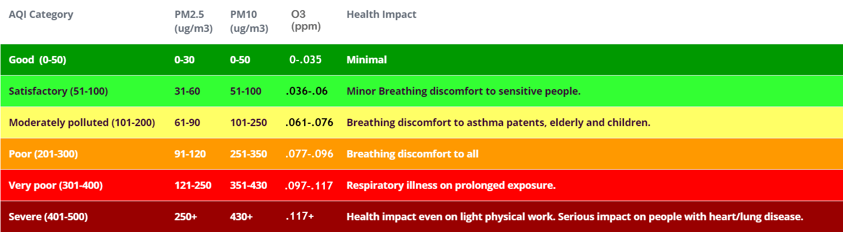
AQI Legend

Slide 5
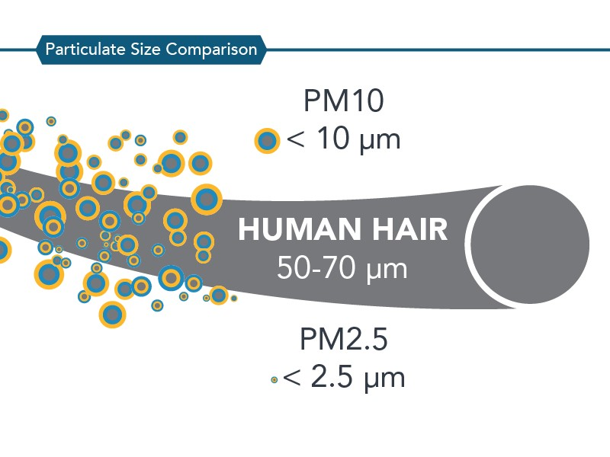
Key Pollutants:
Particulate matter (PM2.5 and PM10)
Particulate matter refers to tiny particles suspended in the air. PM2.5 and PM10 are particles with diameters of 2.5 micrometers and 10 micrometers, respectively. These particles are hazardous when inhaled and can cause respiratory and cardiovascular problems. They can be emitted directly into the air from anthropogenic activities (industry, residential, agriculture, transport) and natural sources (forest fires, volcanic eruptions, etc.)
Ground-level ozone (O3) or the “bad” ozone forms in the air we breathe. It is created by chemical reactions between NOx (oxides of nitrogen produced by combustion) and volatile organic compounds (VOCs). Ground-level ozone comes from pollution emitted from cars, power plants, industrial boilers, refineries, and chemical plants. Ozone pollution can even come from paints, cleaners, motorized lawn equipment. For this reason, levels of ground-level ozone tend to be the highest near urban centers as opposed to rural areas.
Notes:
Volatile organic compounds (VOCs) are organic compounds that have a high vapor pressure at room temperature.^{[1]} High vapor pressure correlates with a low boiling point, which relates to the number of the sample's molecules in the surrounding air, a trait known as volatility.^{[2]}

Slide 6
Methodology:
SQLite
Python Flask
Leaflet.js
Charts.js

Slide 7
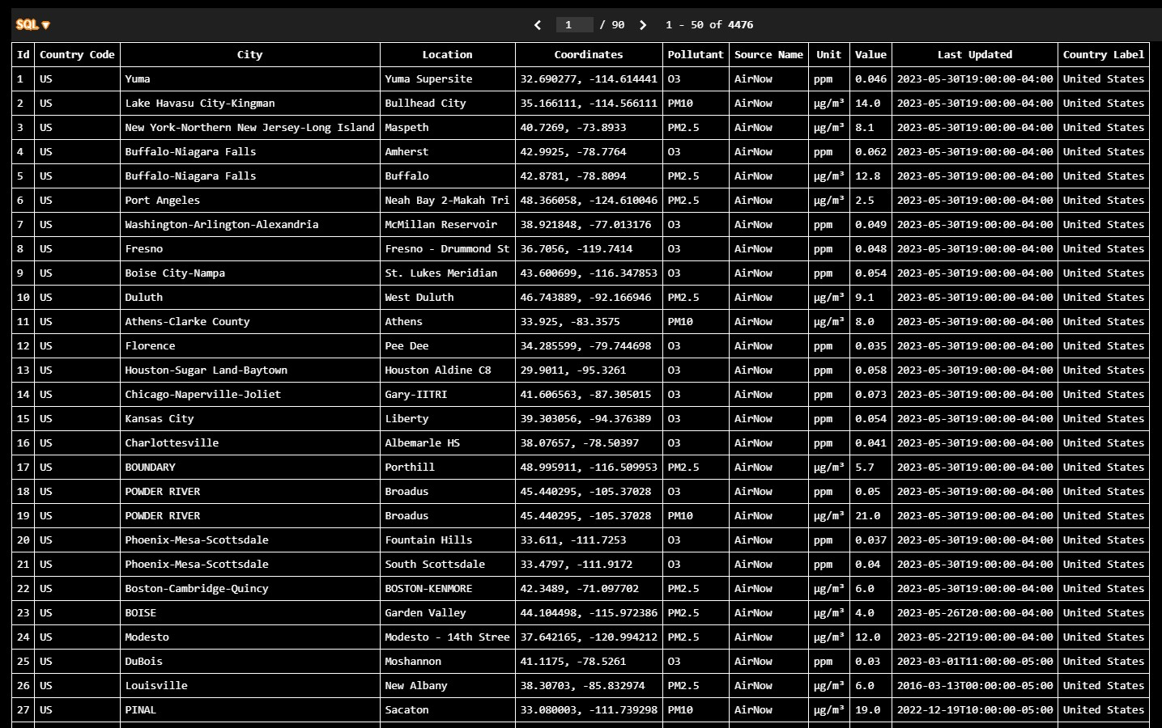
SQLite
Notes:
We saved the data, made primary key - ID, changed some data types

Slide 8
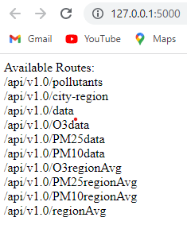
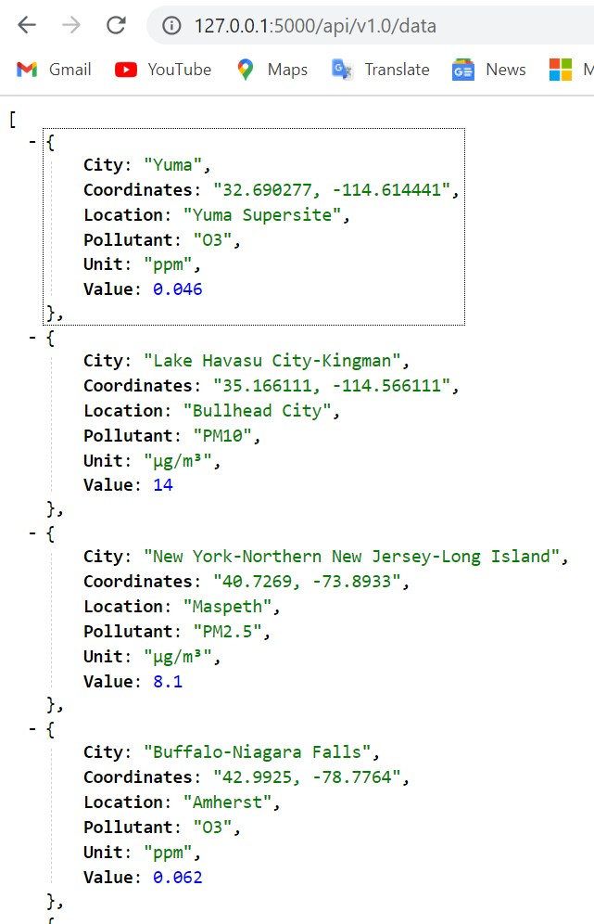
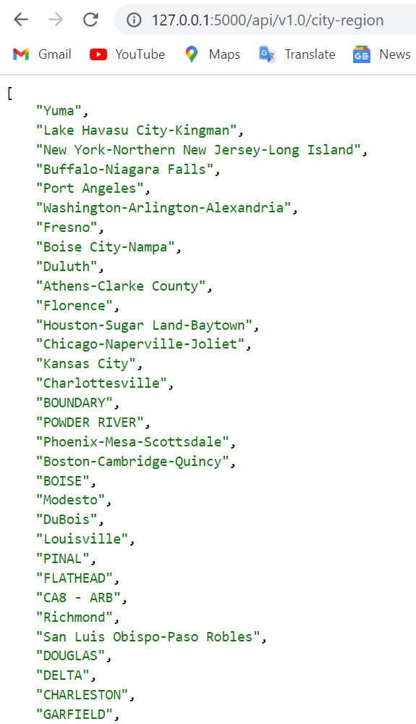
Python Flask

Slide 9
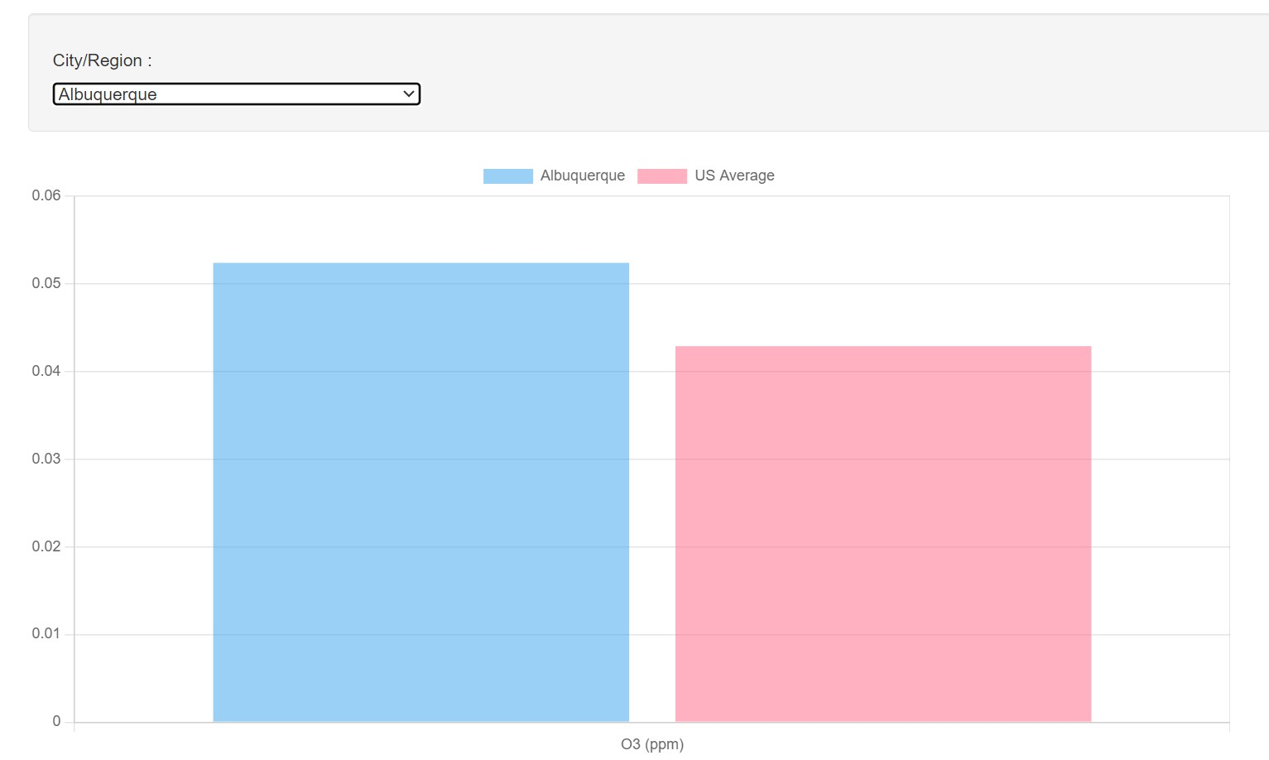
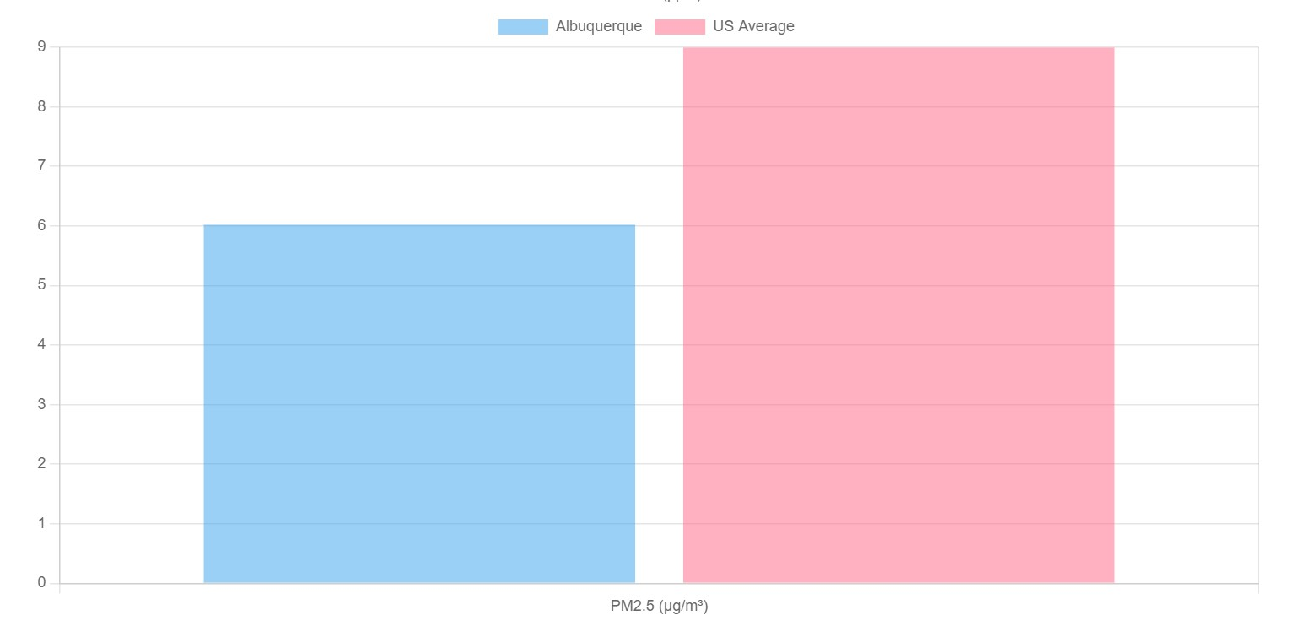
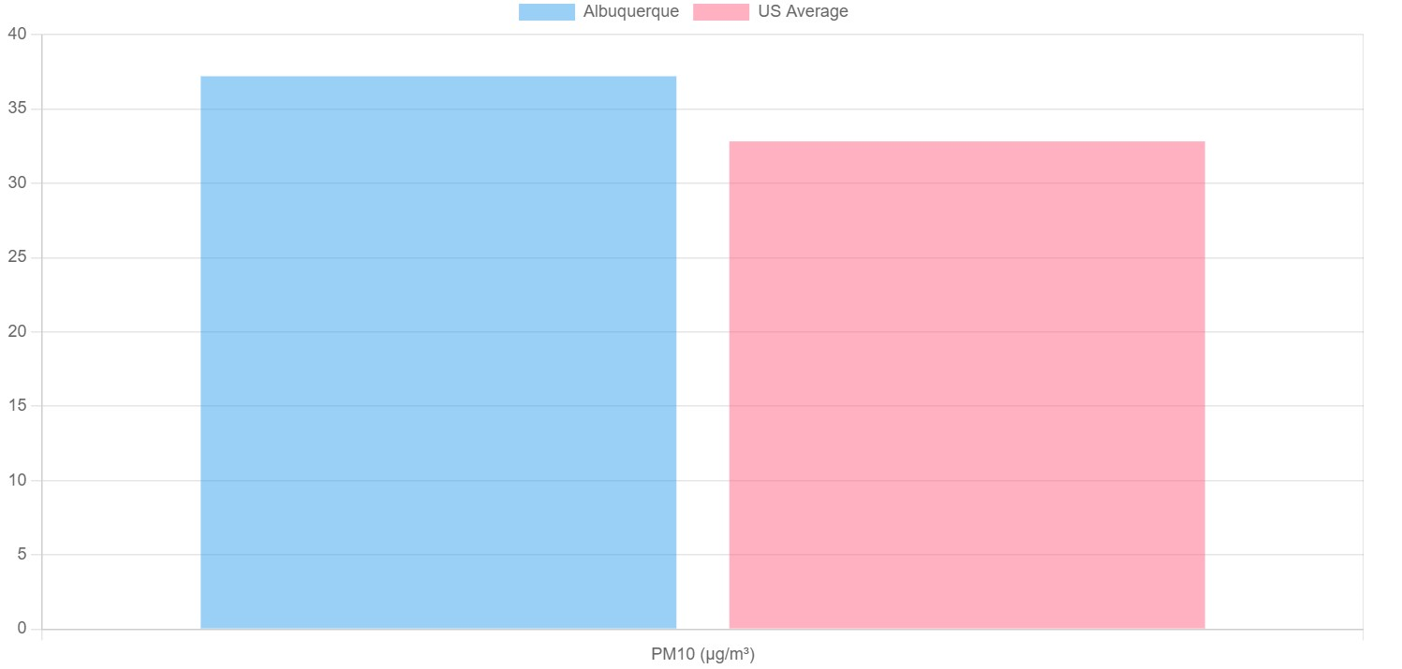
Charts.js

Slide 10
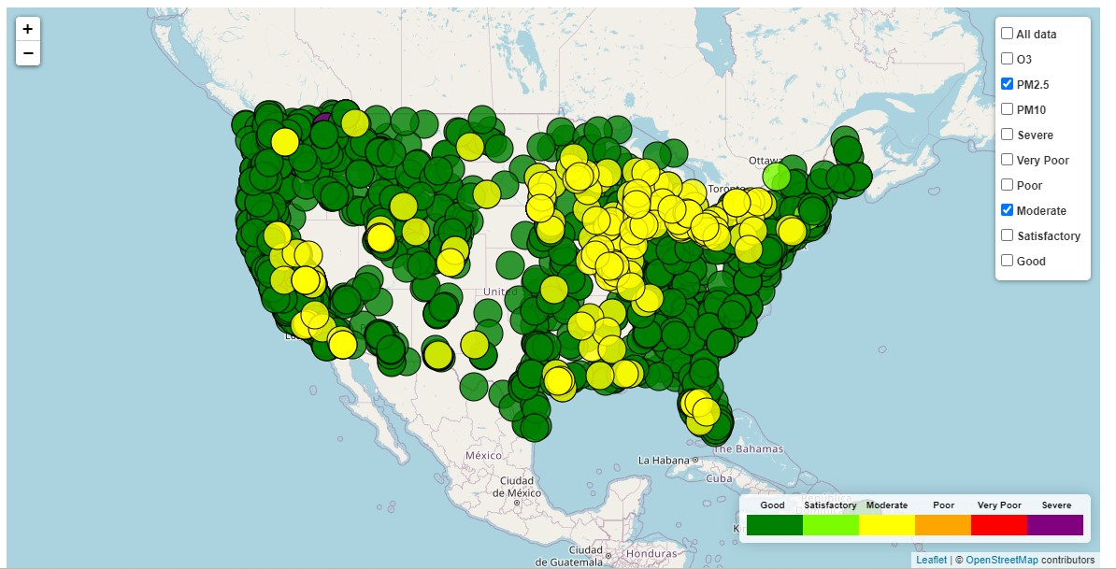
Leaflet.js https://kirbyjudd.github.io/Project-3-Data-Visualizations/

Slide 11
Analysis
The regions with the highest average amount of Moderate to Very Poor O3 air pollution was located in and around Wisconsin, Chicago and Michigan
Some of the lower O3 air polluted regions included the San Francisco/Sacramento region, and near the East and West Coast shorelines
Because PM2.5 and PM10 air pollution is more dynamic than O3, it should usually be in the satisfactory range unless there has been a recent forest fire or other event that would increase particles in the air
The California forest areas had some of the higher PM2.5 readings which could be attributed to forest fires in the area when the air readings were taken

Slide 12
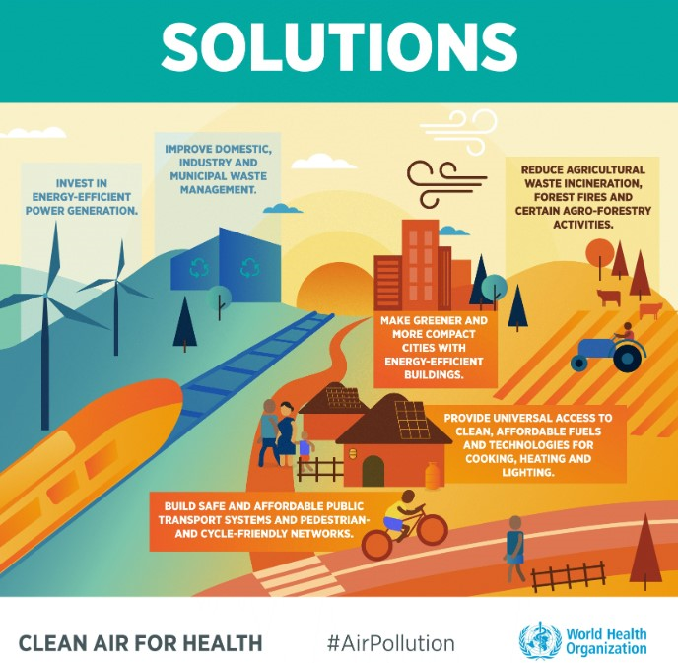
Solutions to tackle Air Pollution
Improve domestic, industry and municipal waste management.
Invest in energy-efficient power generation.
Reduce agricultural waste incineration, forest fires and certain agro-forestry activities.
Make greener and more compact cities with energy-efficient buildings.
Provide universal access to clean, affordable fuels and technologies for cooking, heating and lighting.
Build safe and affordable public transport systems, and pedestrian and cycle-friendly networks.
creator : Word Health Organization (WHO)

Slide 13
Limitations to the dataset
Limited Pollutant Variables: The dataset focus on specific pollutants such as particulate matter(PM2.5 and PM10) and ozone(O3), while excluding other pollutants. Analysing a limited set of pollutants may not provide a comprehensive understanding of the overall air quality or the interactions between different pollutants, which could impact public health or environmental implications;
Seasonal Variations: The dataset covers data for only few months, which may not capture long-term variations of the pollutants values;
Monitoring Stations Distribution: The dataset has uneven distribution of monitoring stations across the study area. Some regions have more monitoring stations, and other are underrepresented.

Slide 14
Data Source
OpenAQ. (2023). Air Quality Data for USA Cities. Retrieved June 6, 2023 from https://docs.openaq.org/reference/latest_get_v2_latest_get
https://public.opendatasoft.com/explore/dataset/openaq/table/?disjunctive.city&disjunctive.location&disjunctive.measurements_parameter&sort=measurements_lastupdated

Slide 15
THANK YOU

